Slide 1

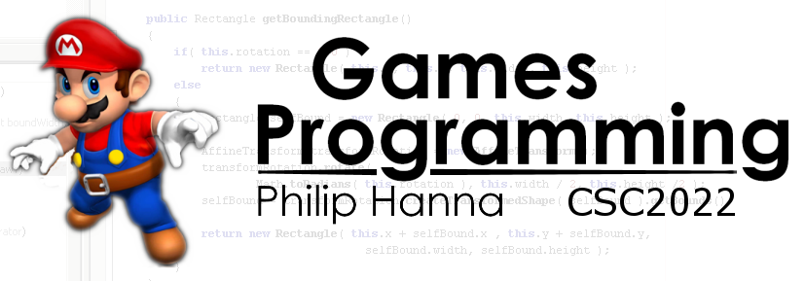
Agile and Lean
Introduction to the principles behind agile and lean software development.
Part 2 – Scrum

Slide 2
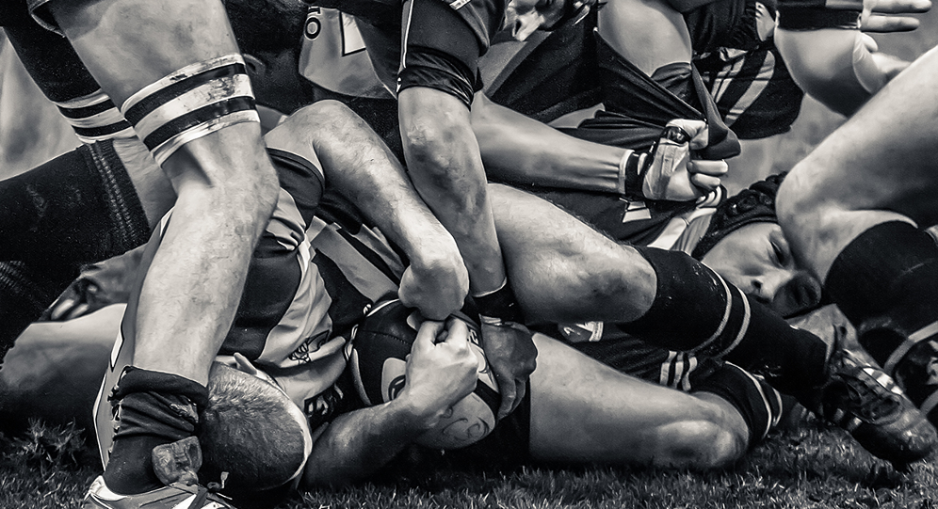
Scrum
Software Development

Slide 3
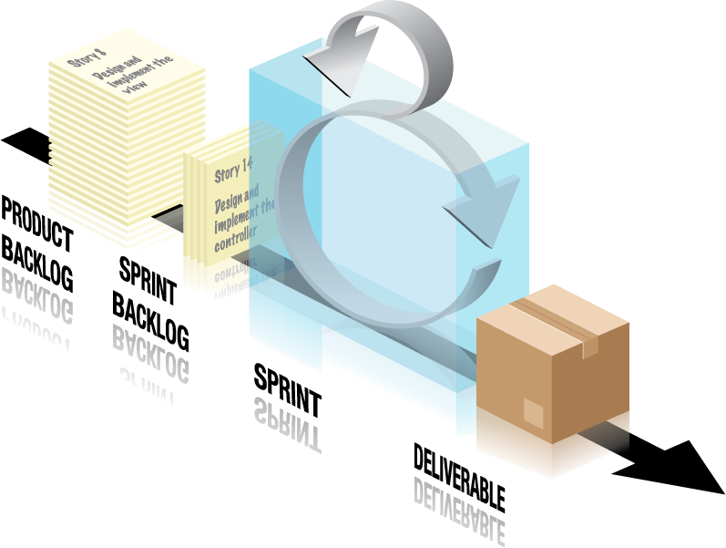
Scrum is a popular agile software development methodology.
Scrum projects move forward through a series of iterations, called sprints.
Aside: Scrum gets its name from rugby – the event that occurs when players group to restart the game after a minor infraction.

Slide 4
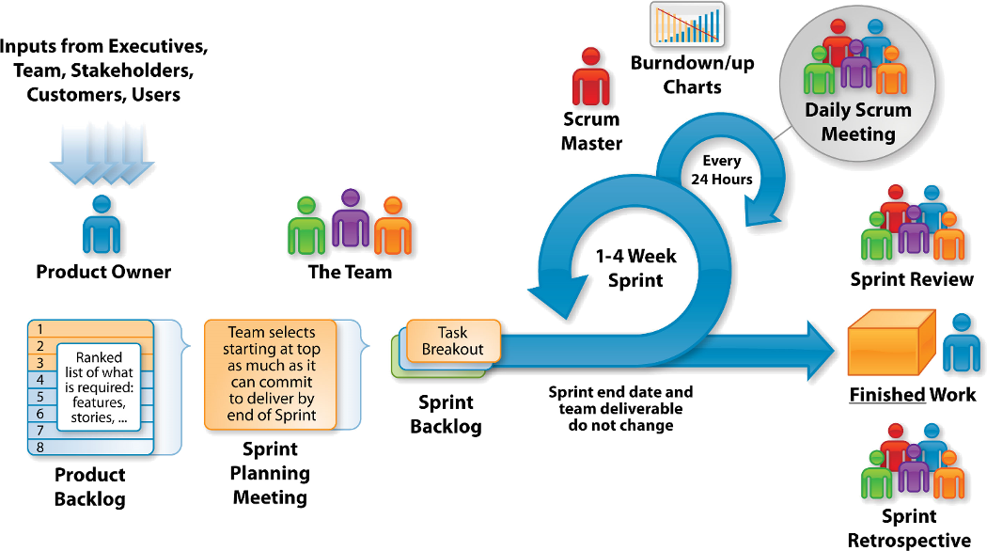
: Elements

Slide 5



: The Scrum Team
The product owner has the vision of what needs to be developed and conveys this to the scrum team.
The development team delivers the vision (in PSIs - potentially shipable increments).
The team comprises several individuals with cross-functional skills (analysis, development, testing, etc.).
The Scrum Master enforces the rules of scrum and acts as a buffer to any distracting influences (they facilitate, not manage).

Slide 6
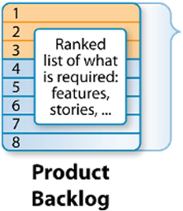
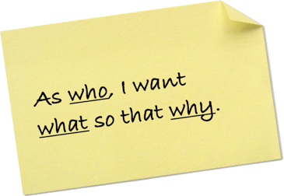
What needs to be delivered is stored within an evolving product backlog - a prioritised list of requirements, which can include everything from business features to technical issues or bugs.
The requirements are concisely captured on sticky notes or on index cards in the form of user stories.

Slide 7
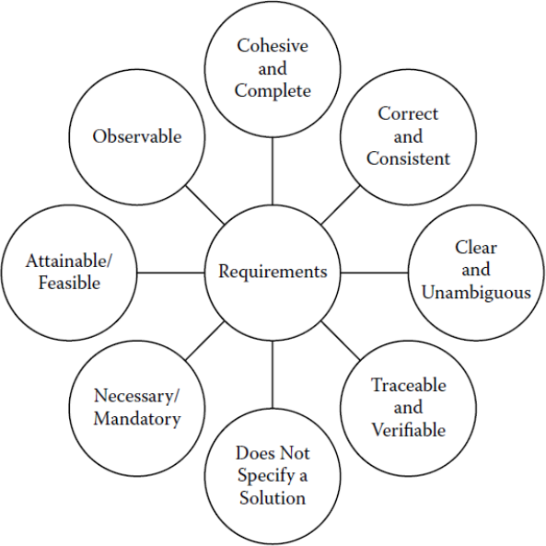
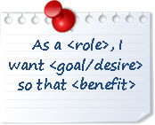
Each user story is concise and written from the perspective of customer interaction with the product.
It is a short and clear statement of who, what and why.

Slide 8
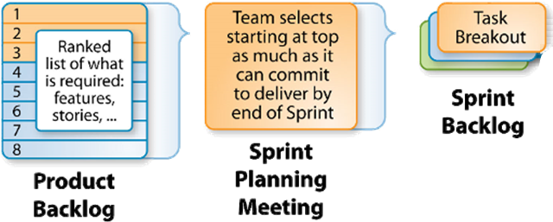
Each sprint is preceded by a sprint planning meeting to select which user stories will be implemented.
The product owner, with input from the team, will prioritise the user stories to be next completed.
The development team will then decide how much time and effort is needed to deliver the story.
This process continues until all the available sprint time has been allocated.

Slide 9
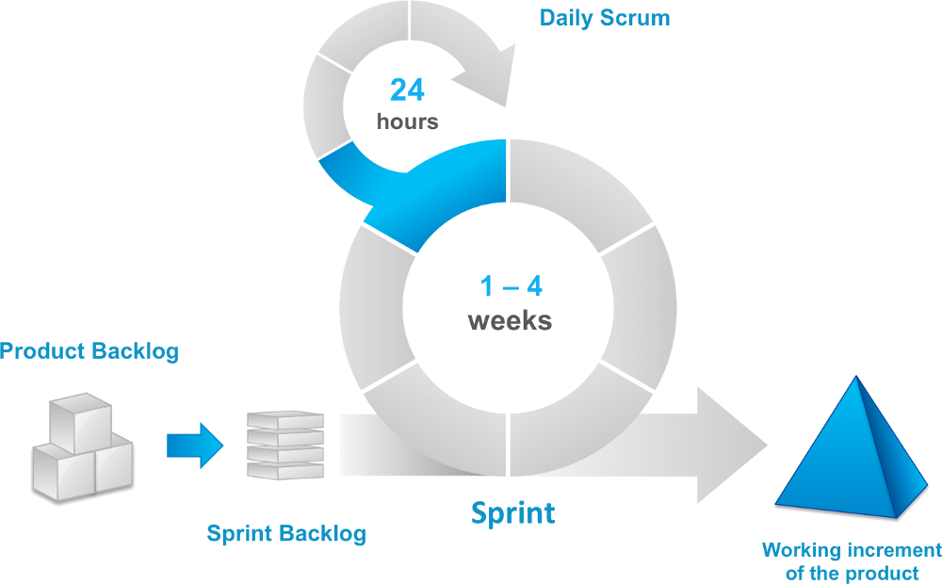
The Sprint

Slide 10
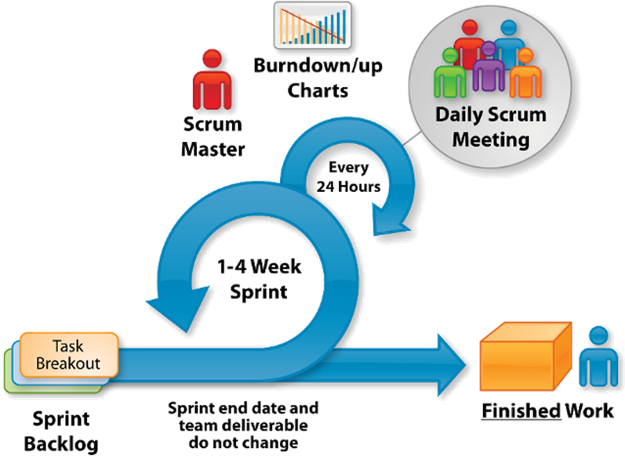
Once started the Sprint backlog cannot change (user stories added or removed) – other than in exceptional circumstances.
Unlike traditional project management (centralised control), the Scrum team manages their own progress (devolved control).
A burn-down chart tracks how much work remains. Short stand-up meetings are held each morning to review progress.

Slide 11

Key takeaways:
Scrum is one of the more popular agile approaches.
Scrum offers a devolved form of project management where the development team and product owner manage their own time.

